Slide 1
MLIR: A Compiler Infrastructure for the End of Moore’s Law（Google 2020）

Slide 2
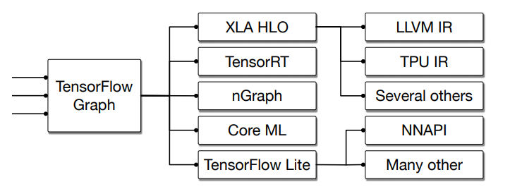
Background
“one size fits all” approach: a single abstraction level to interface with the system. The LLVM Intermediate Representation (IR) is roughly “C with vectors”. Such mapping from C/C++ to specific domains is straightforward.
“multi-level” IR : The gap between a higher- or lower-level abstraction. Many frameworks develop multi-level IR to solve domain-specific problems between the higher and lower-level abstraction.
Their engineering and implementation cost remains high.
Lead to lower quality compiler systems.

Slide 3
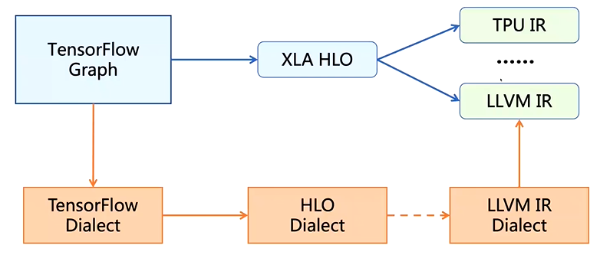
MLIR(Multi-Level Intermediate Representation)
A novel approach to building reusable and extensible compiler infrastructure. MLIR aims to address software fragmentation, improve compilation for heterogeneous hardware, significantly reduce the cost of building domain specific compilers, and aid in connecting existing compilers together.

Slide 4
IR Design Principles
Little builtin, everything customizable.
Progressive lowering.
Maintain higher-level semantics.
IR validation.
Declarative rewrite patterns.
Source location tracking and traceability.

Slide 5
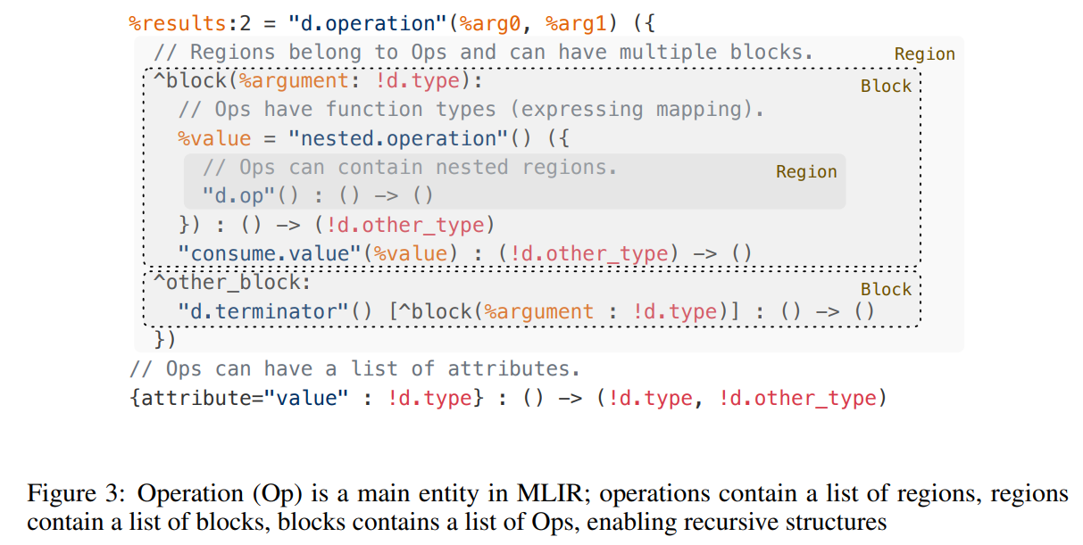
IR Design Details
Operations

Slide 6

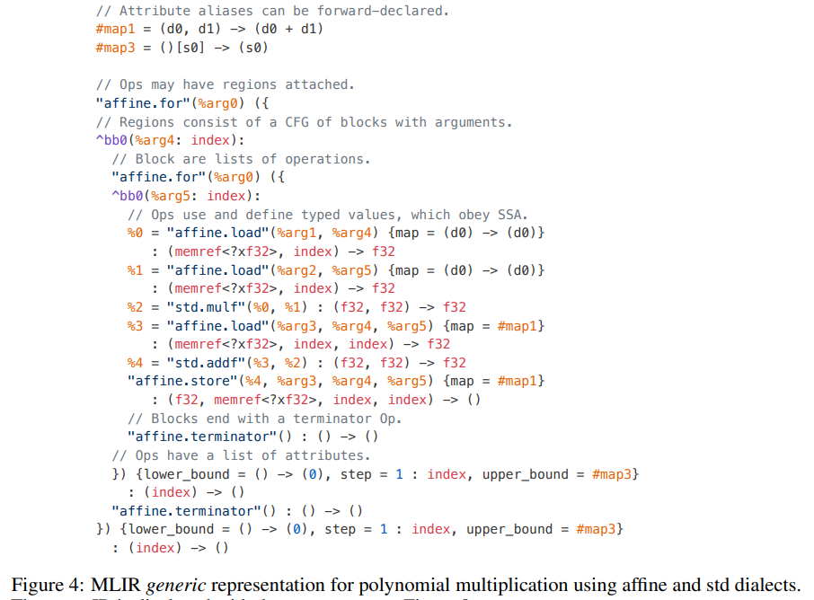
IR Design Details
Attributes
Regions and blocks
An instance of an Op may have a list of attached regions. A region provides the mechanism for nested structure in MLIR.
A region contains a list of blocks, and a block contains a list of operations.

Slide 7
IR Design Details
Type System
in the Op that produces the value or in the block .
user-extensible, and may refer to existing foreign type systems
Standard types
a standardized set of commonly used types, including arbitrary precision integers, standard floating point types, and simple common containers—tuples, multi-dimensional vectors, and tensors
Functions and modules
A module is an Op with a single region containing a single block, and terminated by a dummy Op that does not transfer the control flow
A function is an Op with a single region, with arguments corresponding to function arguments.

Slide 8
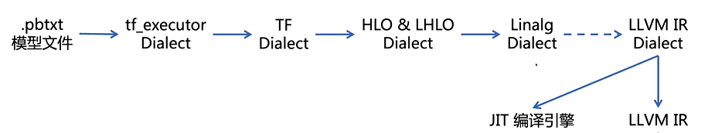
IR Design Details
Dialects
provide a logical grouping of Ops, attributes and types under a unique namespace.
greater reuse, extensibility and provides flexibility

Slide 9
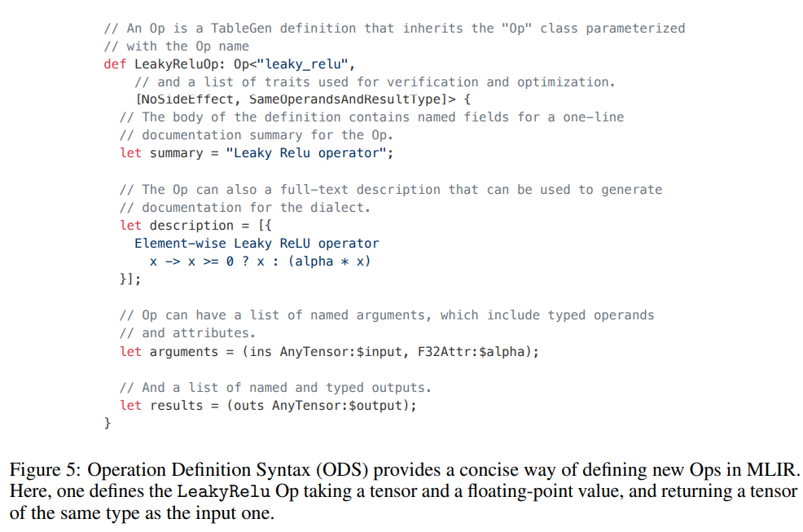
IR Design Details
Table Gen
uses Table Gen-based specification for Operation Descriptions (ODS), defining the structure of an Op and components of its verifier declaratively

Slide 10
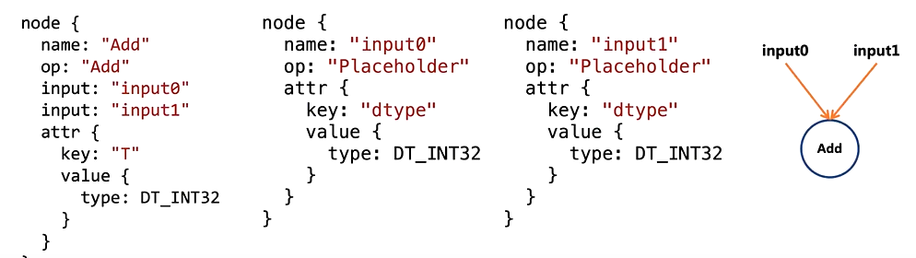
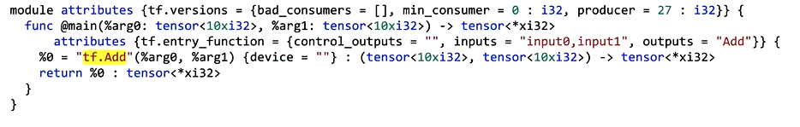
IR Design Details

Slide 11
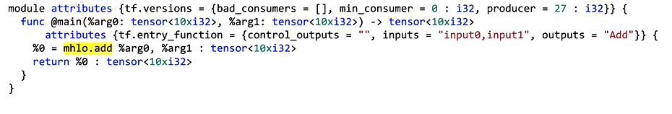
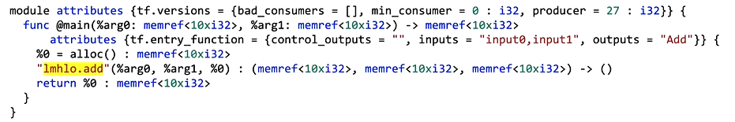
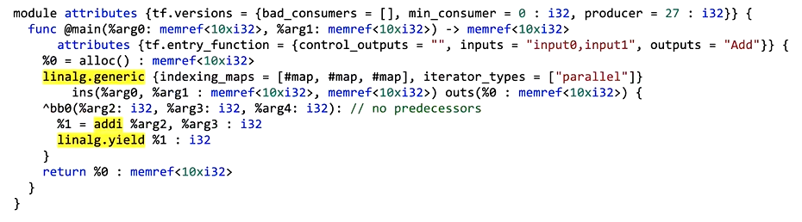
IR Design Details

Slide 12
下一步优化的问题
优化MLIR表达式的优化（MLIR表达式的冗余部分）。
Lowering过程中的针对特定硬件的并行优化。
Pass的优化。（内联Pass、死代码消除等）。
MLIR的源语言前端。

Slide 13
谢 谢！

